Slide 1
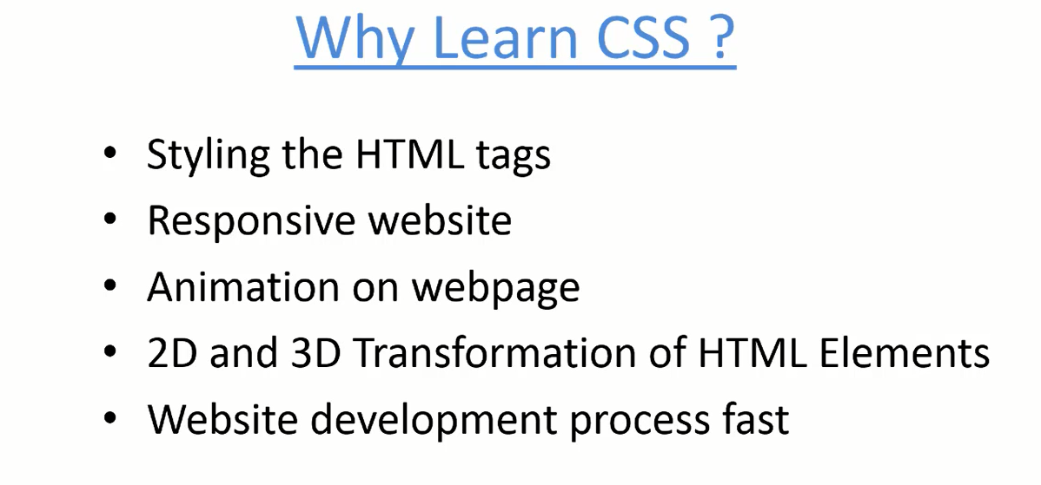
CSS = Cascading Style Sheet

Slide 2
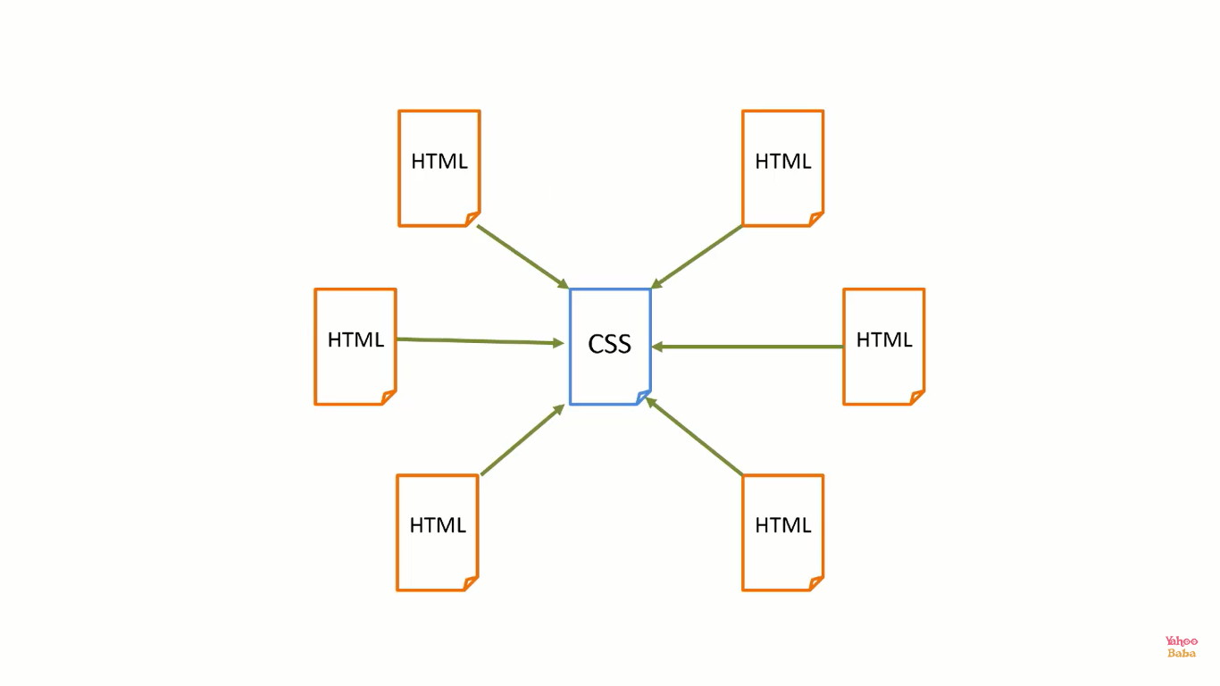

Slide 3
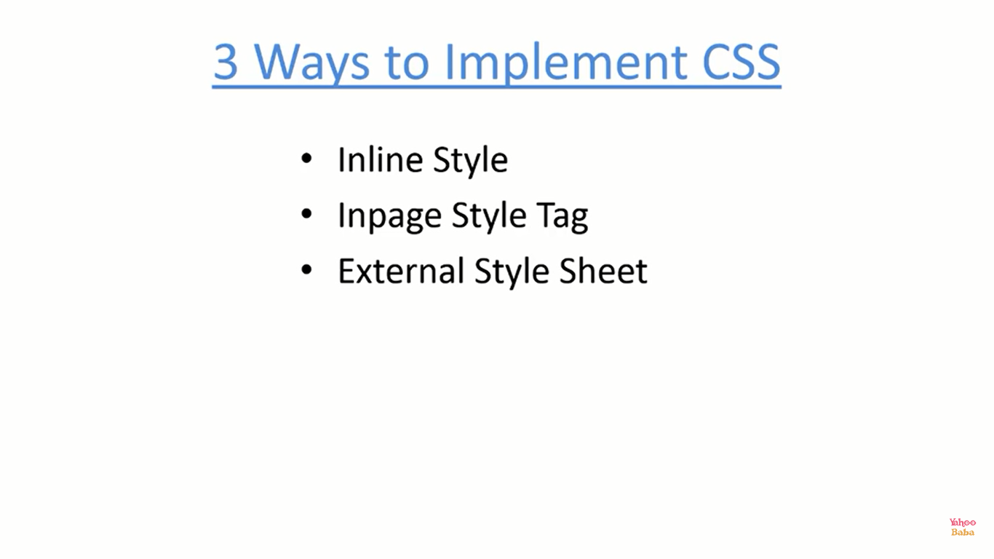

Slide 4
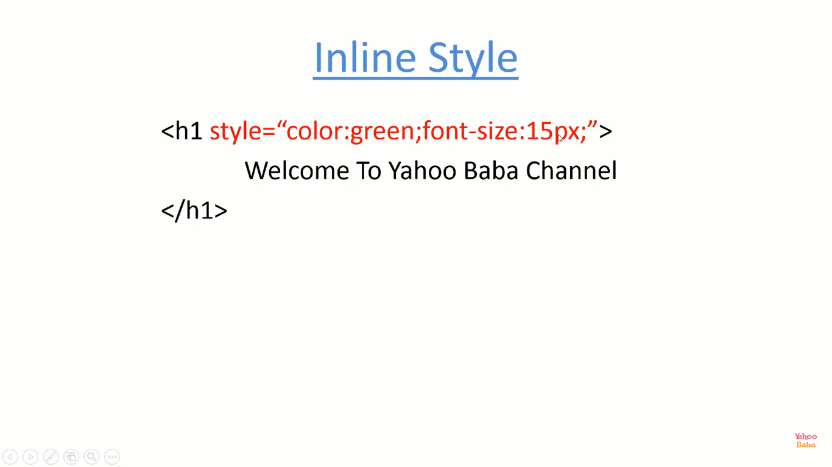

Slide 5
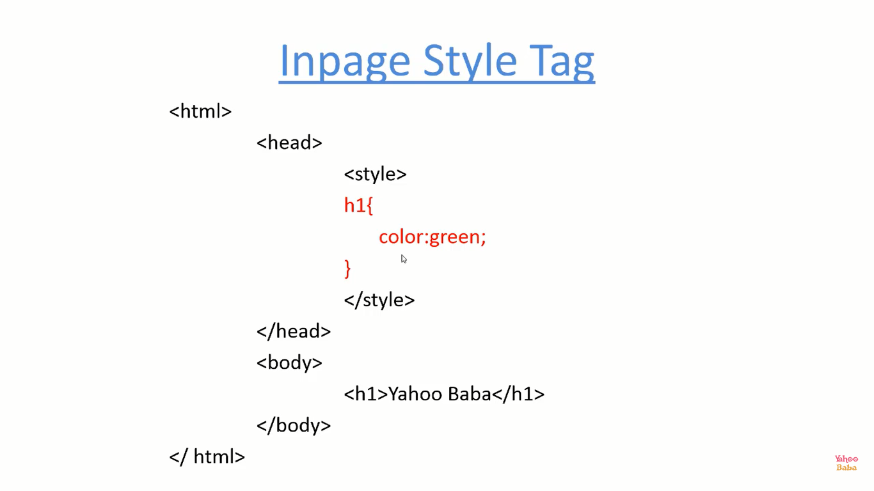

Slide 6
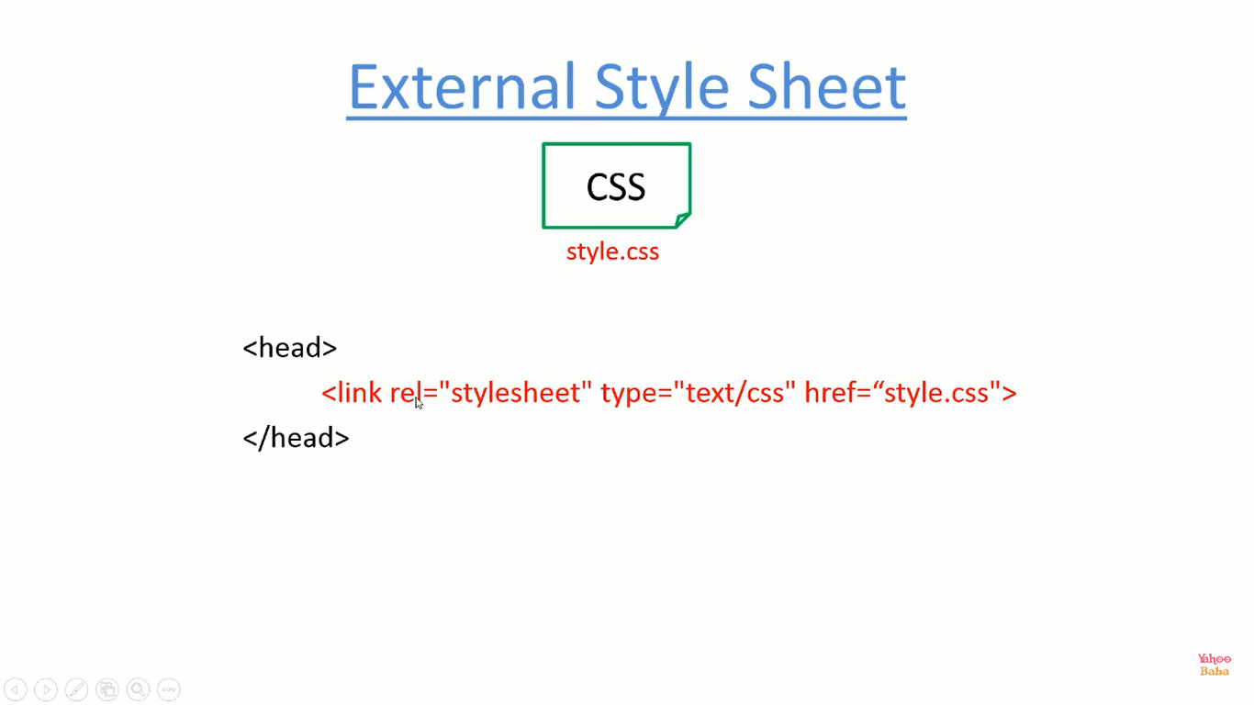

Best Way 👍👍

Slide 7
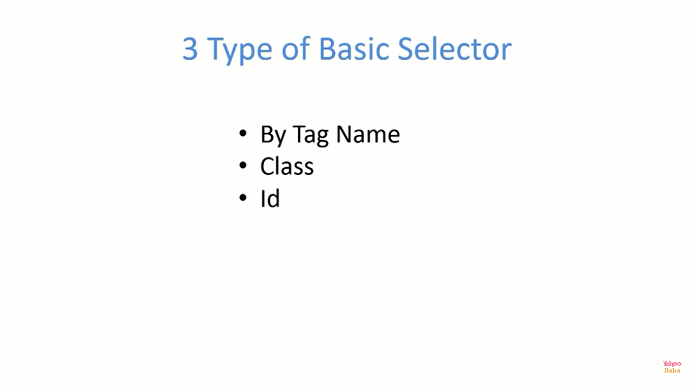
Descendent Selector

Slide 8
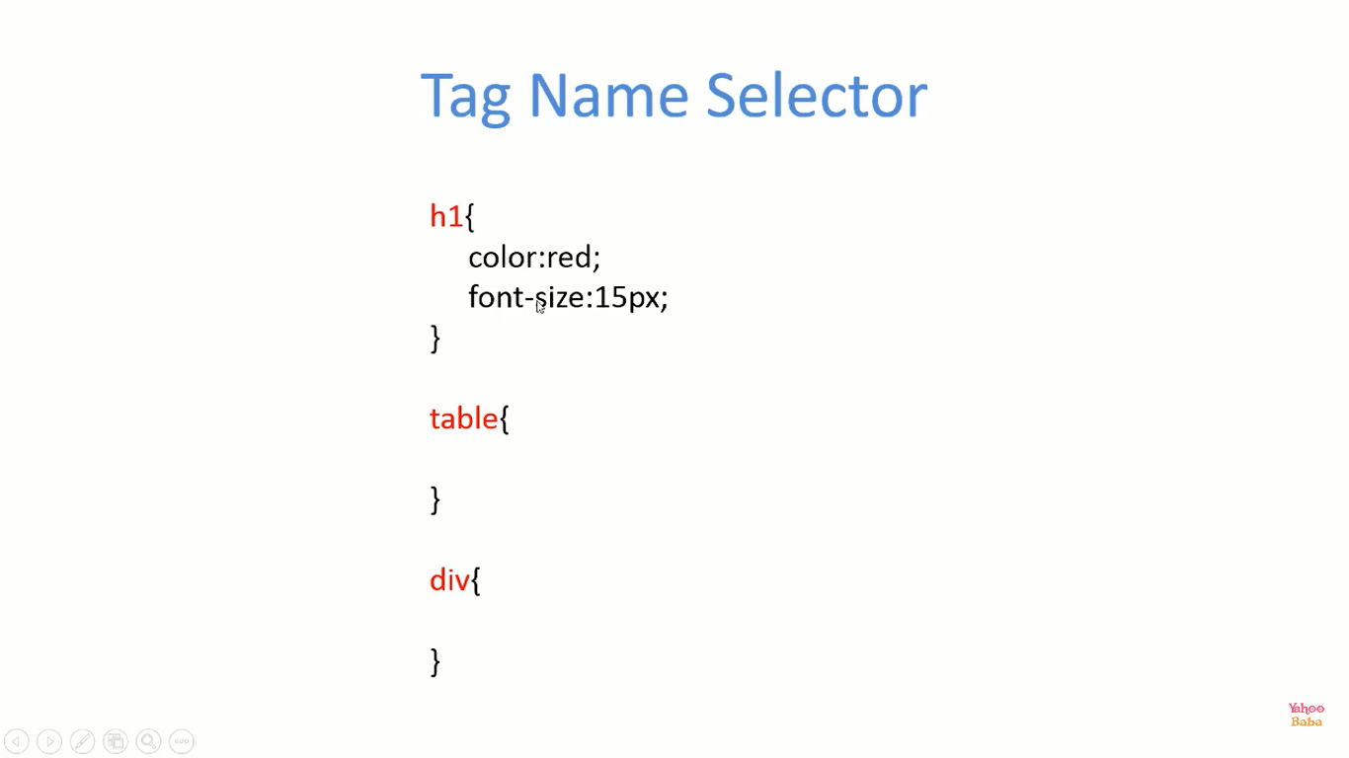

Slide 9
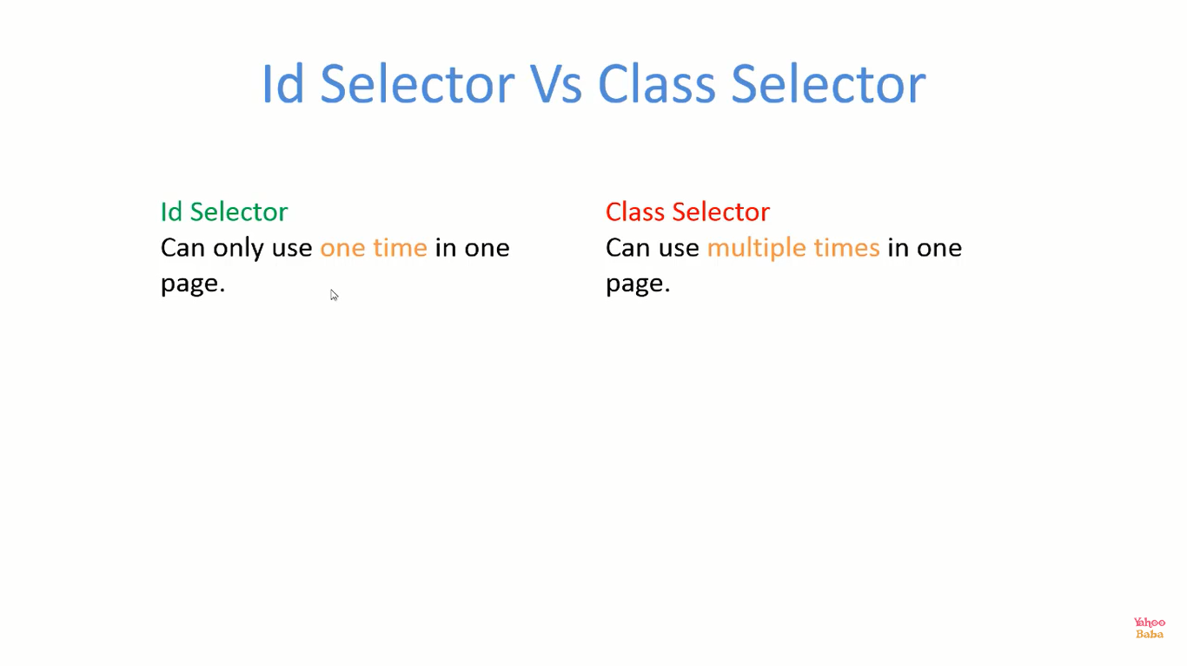

Slide 10
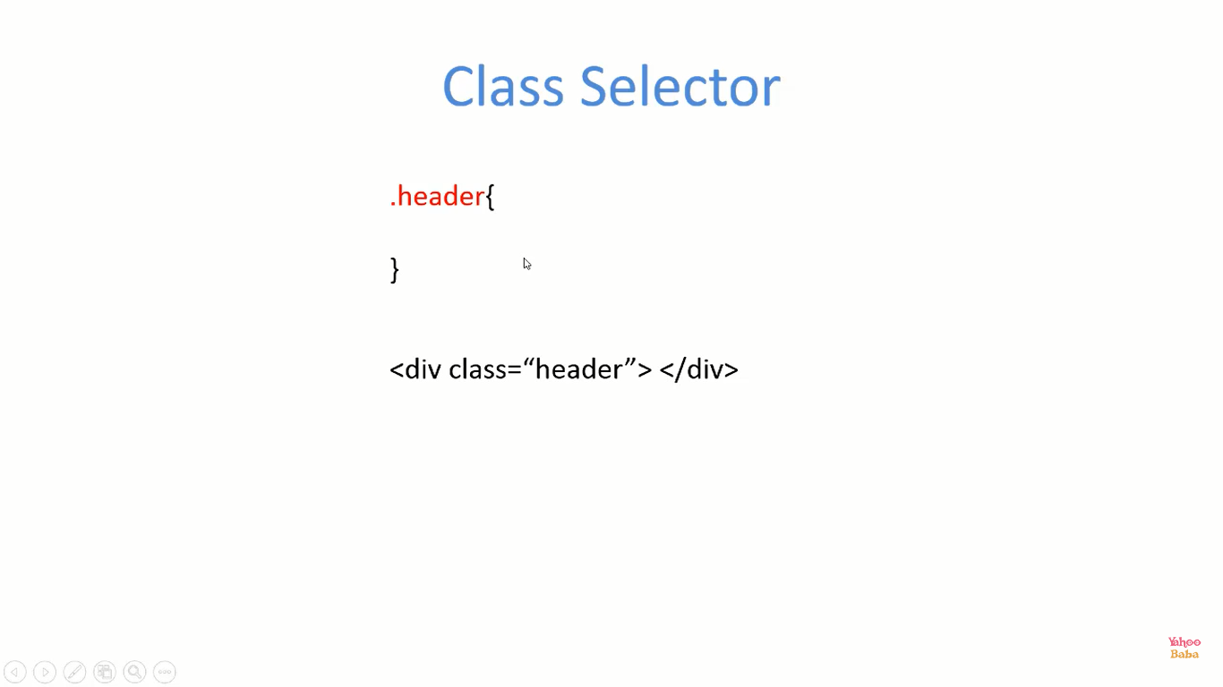

Slide 11
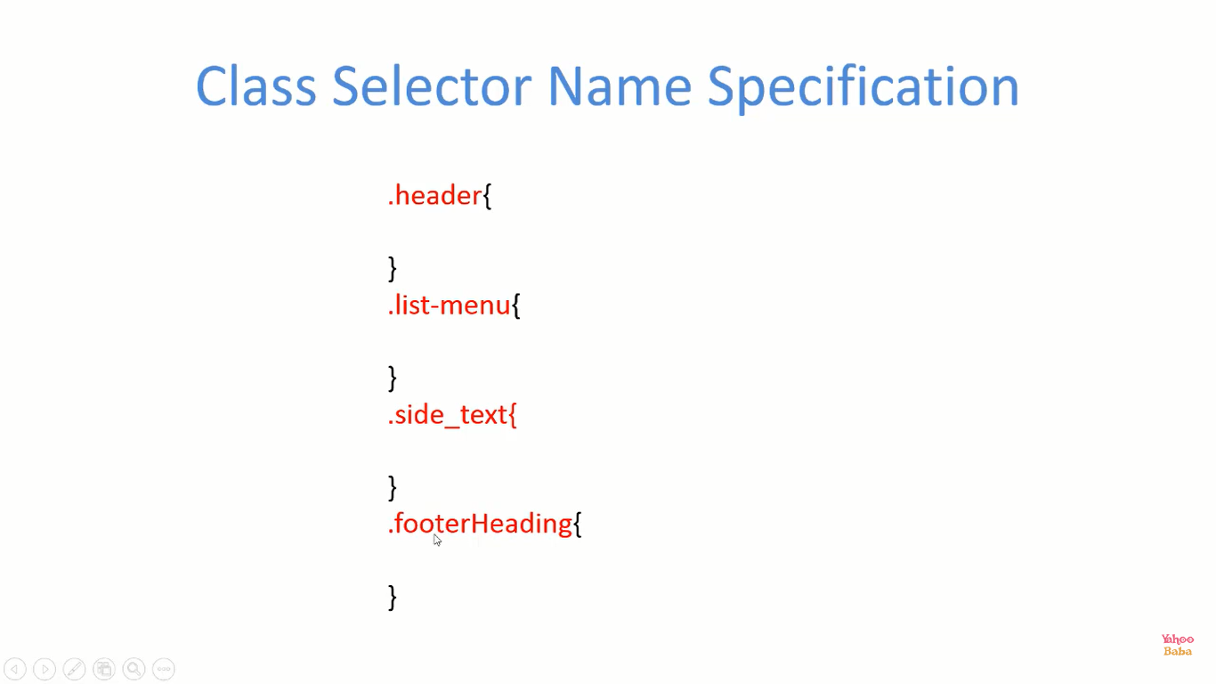

Slide 12
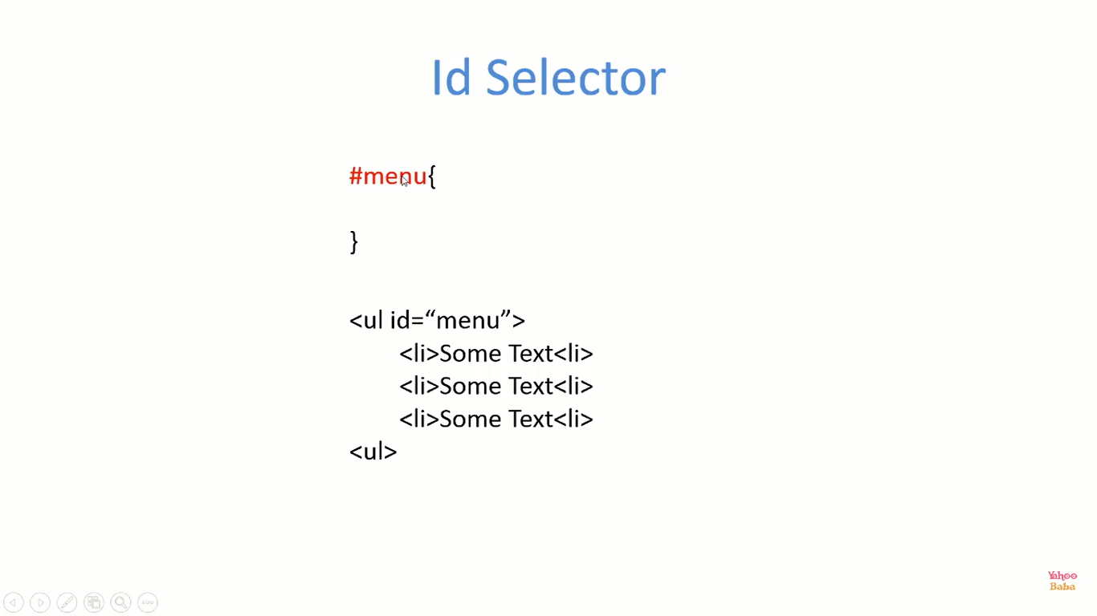

Slide 13
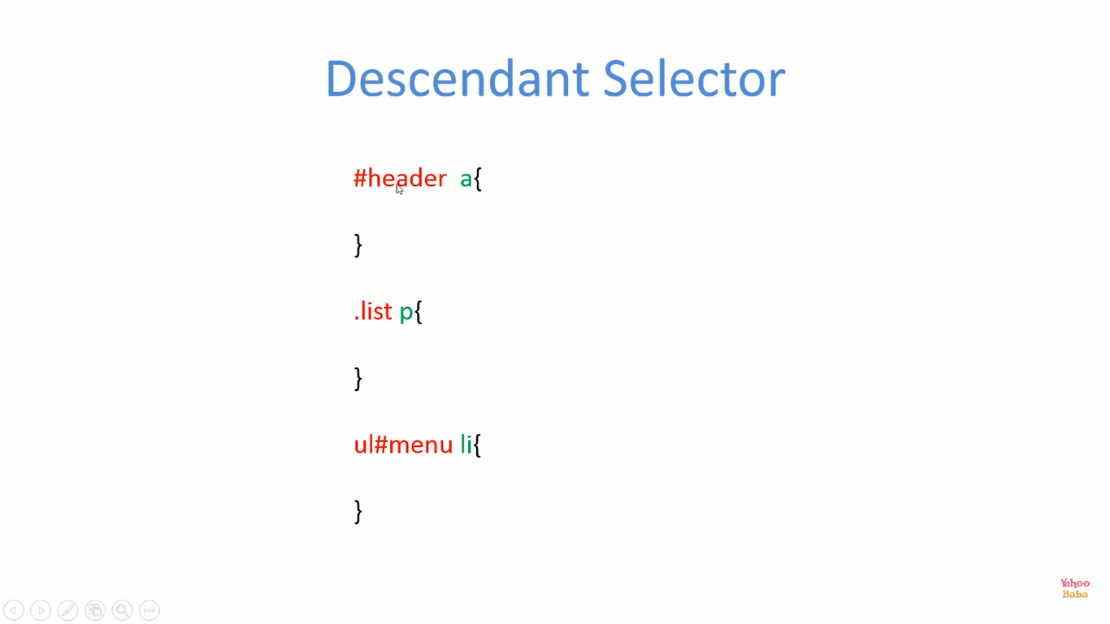

Slide 14
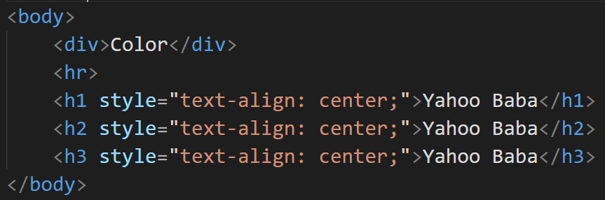
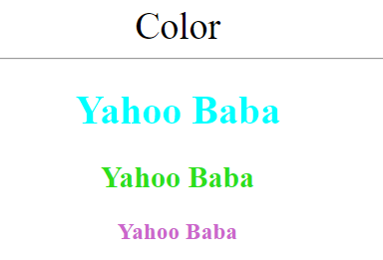
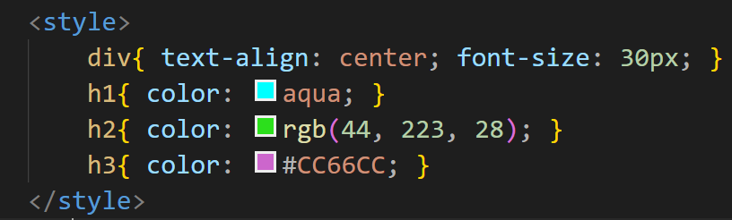
color

Slide 15
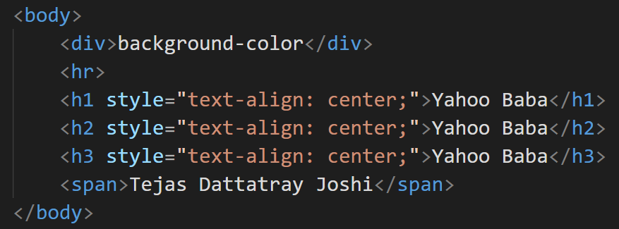
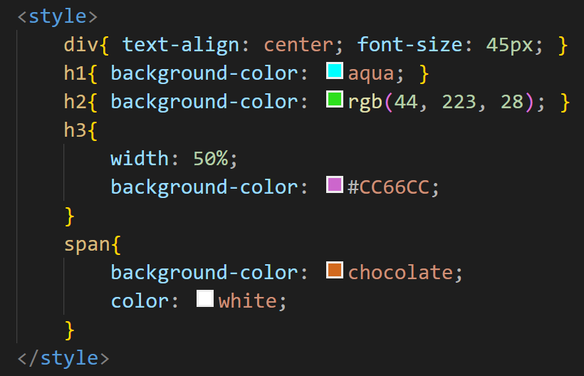
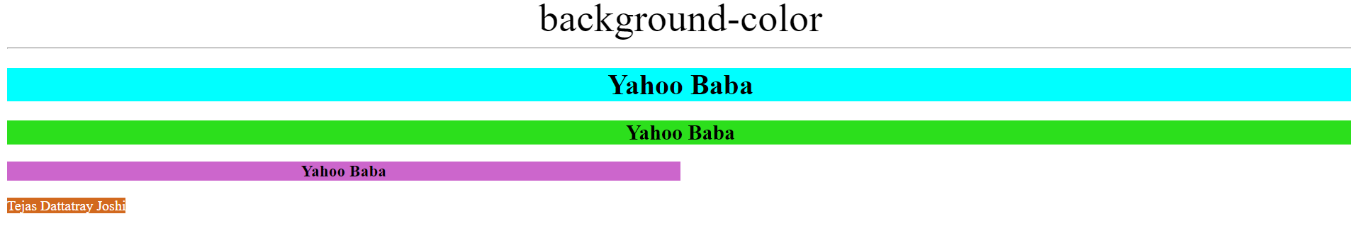
background-color

Slide 16
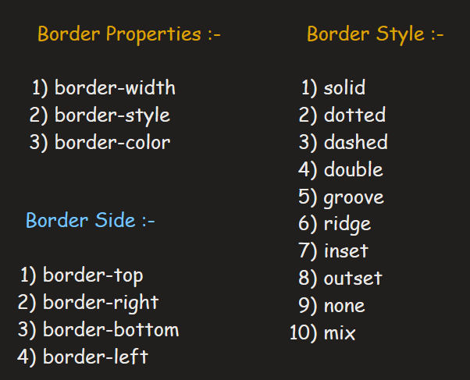
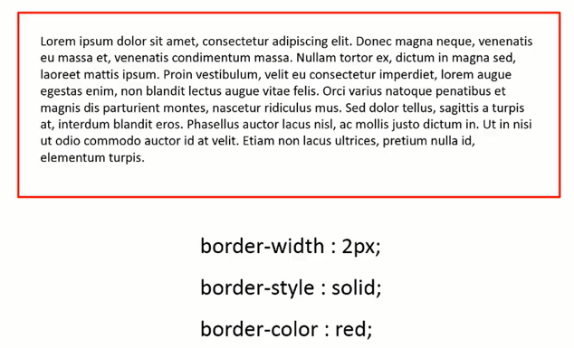

border

Slide 17
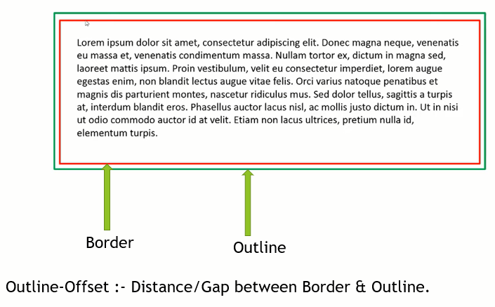
outline

Slide 18
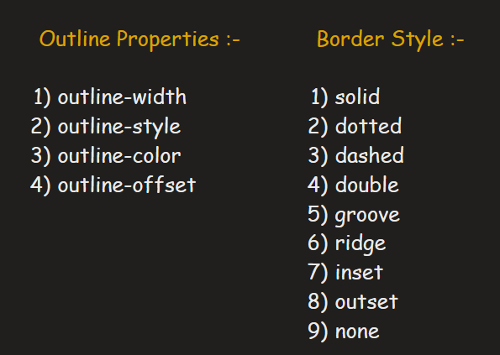
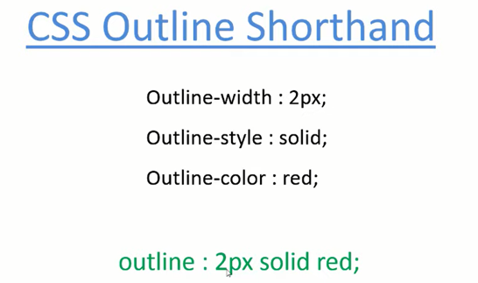
outline

Slide 19
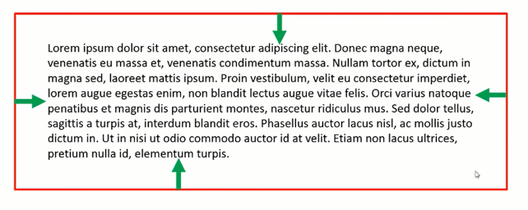
padding

Slide 20
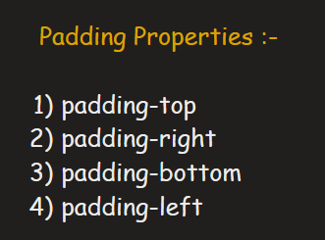
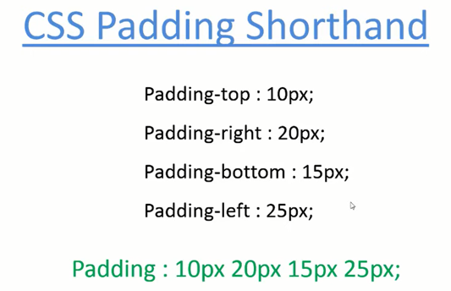
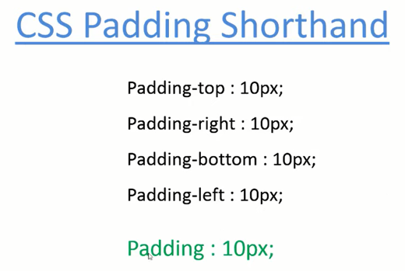
padding
Padding: 10px 20px;
Padding-top : 10px
Padding-bottom : 10px
Padding-left : 20px
Padding-right : 20px
Padding: 10px auto;
Padding-top : 10px
Padding-bottom : 10px
Equal padding from
left & right

Slide 21
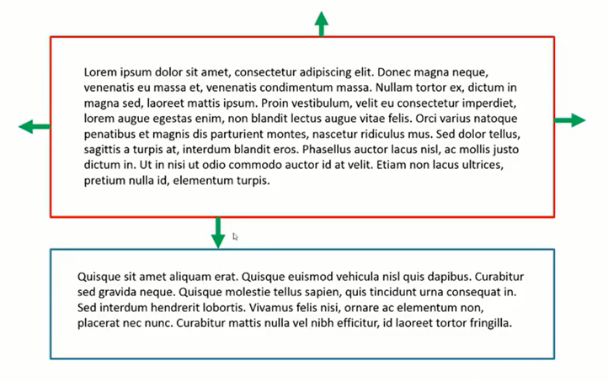
margin

Slide 22
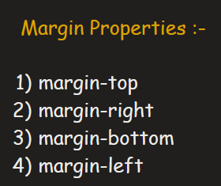
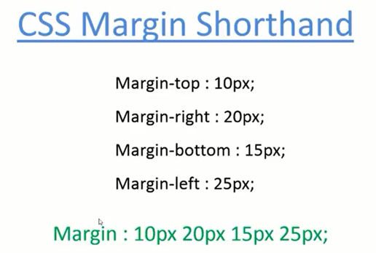
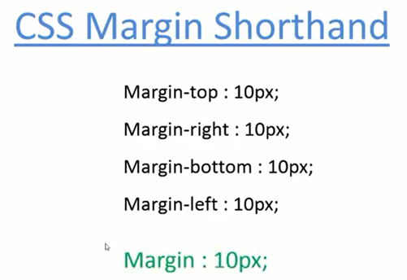
margin
margin : 10px 20px;
margin-top : 10px
margin-bottom : 10px
margin-left : 20px
margin-right : 20px
margin: 10px auto;
margin-top : 10px
margin-bottom : 10px
Equal margin from
left & right

Slide 23
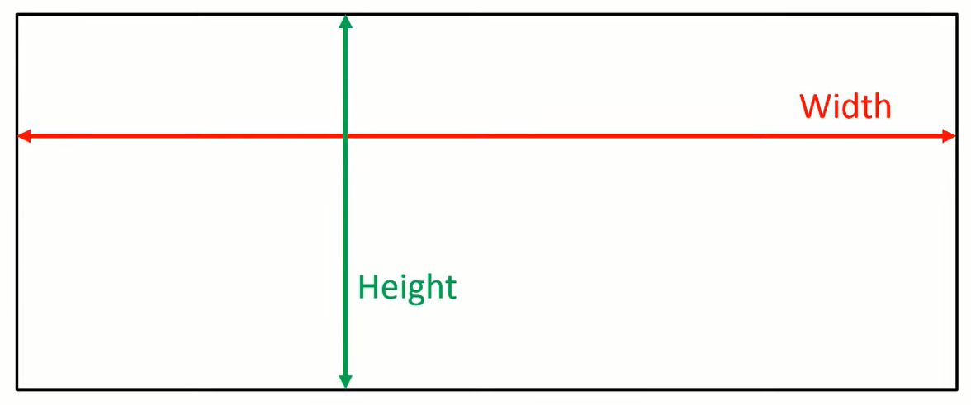
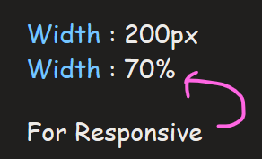
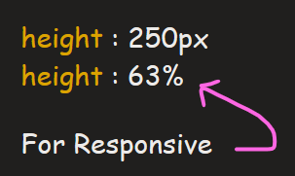
height & width

Slide 24
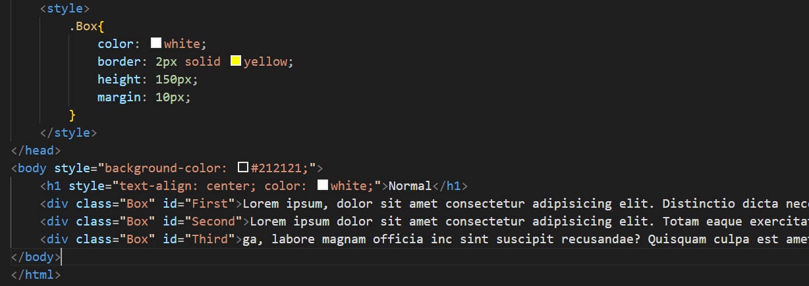
min-height & max-height
min-height :- Minimum Height of box is height beyond which even text inside box is not too much and
space remaining.
2) max-height :- Maximum Height of box is height upto to which height increases automatically as text
inside box increases beyond which height not increases.

Slide 25
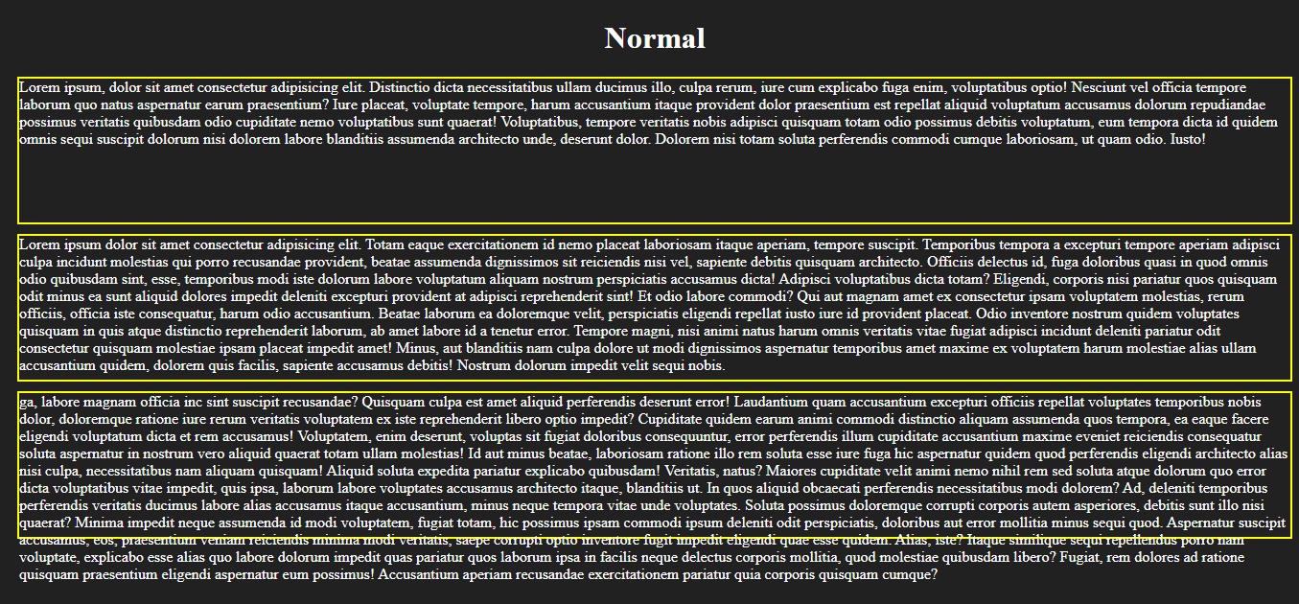

Slide 26
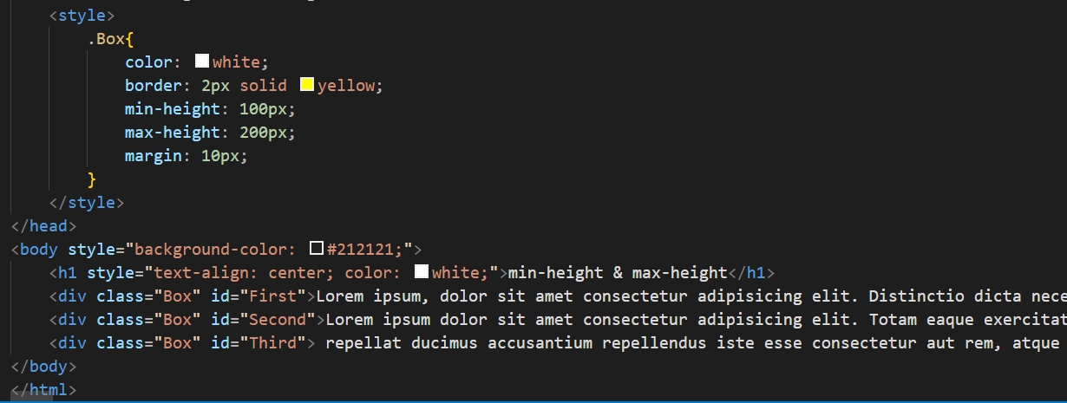

Slide 27
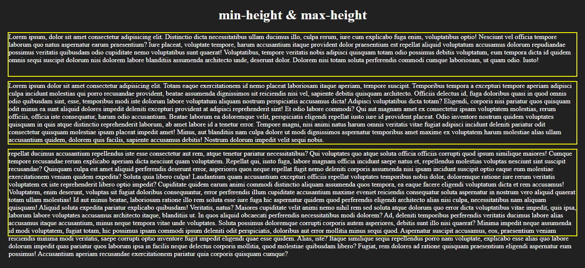

Slide 28
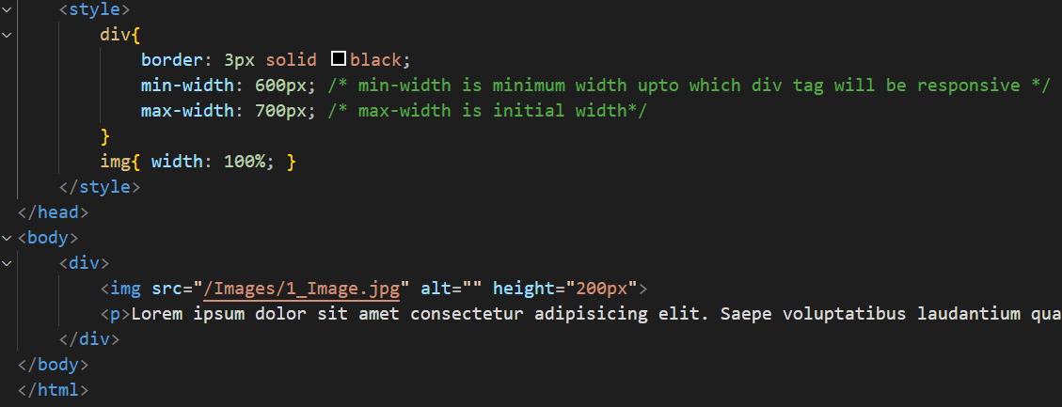
min-width & max-width
min-width :- Minimum Width of box is width beyond which width of box is not decreases as screen-size
decreases.
2) max-width :- Maximum Width of box is width upto which width increases beyond that width not increases.

Slide 29

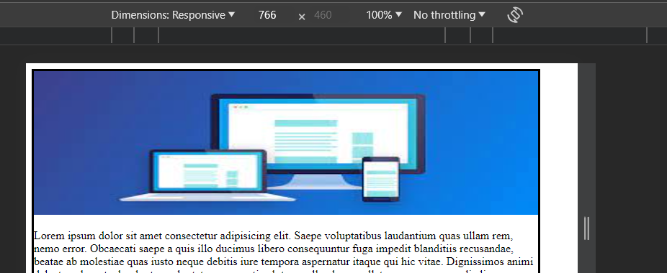

Slide 30
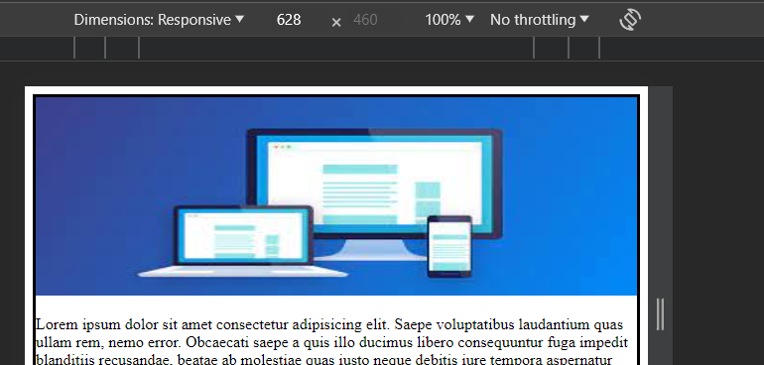
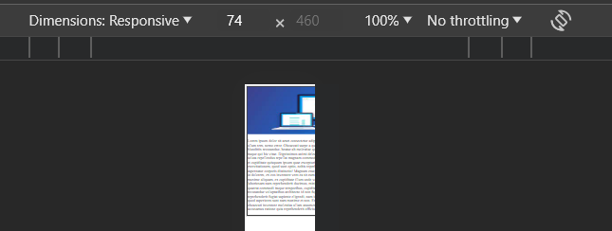

Slide 31
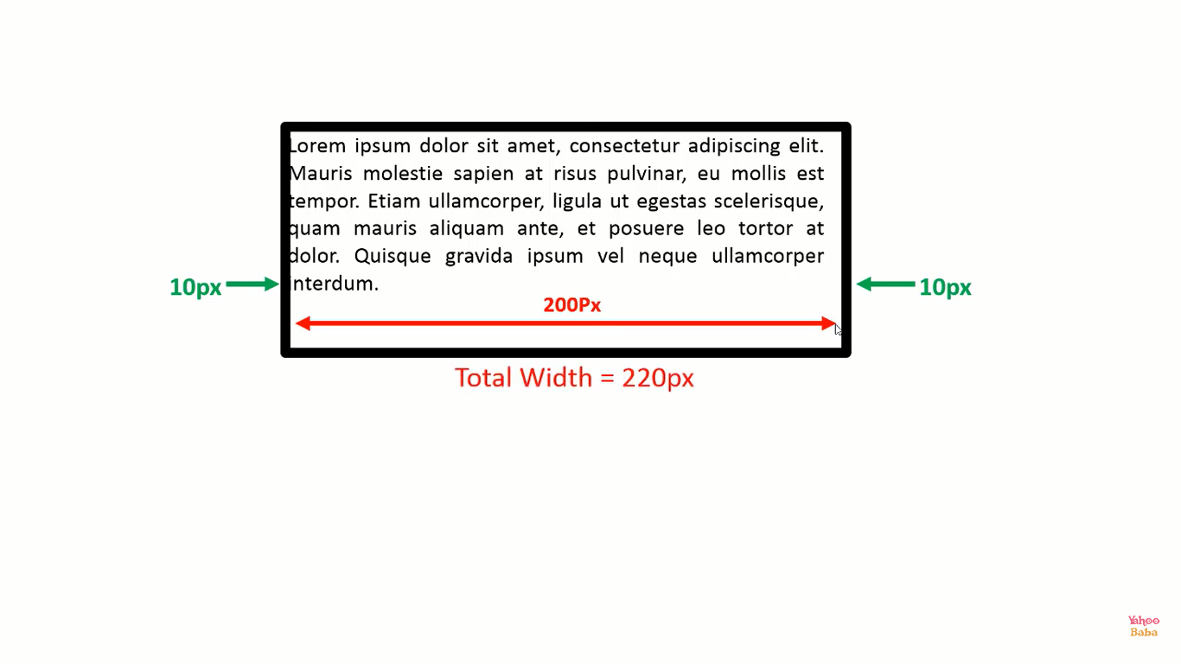
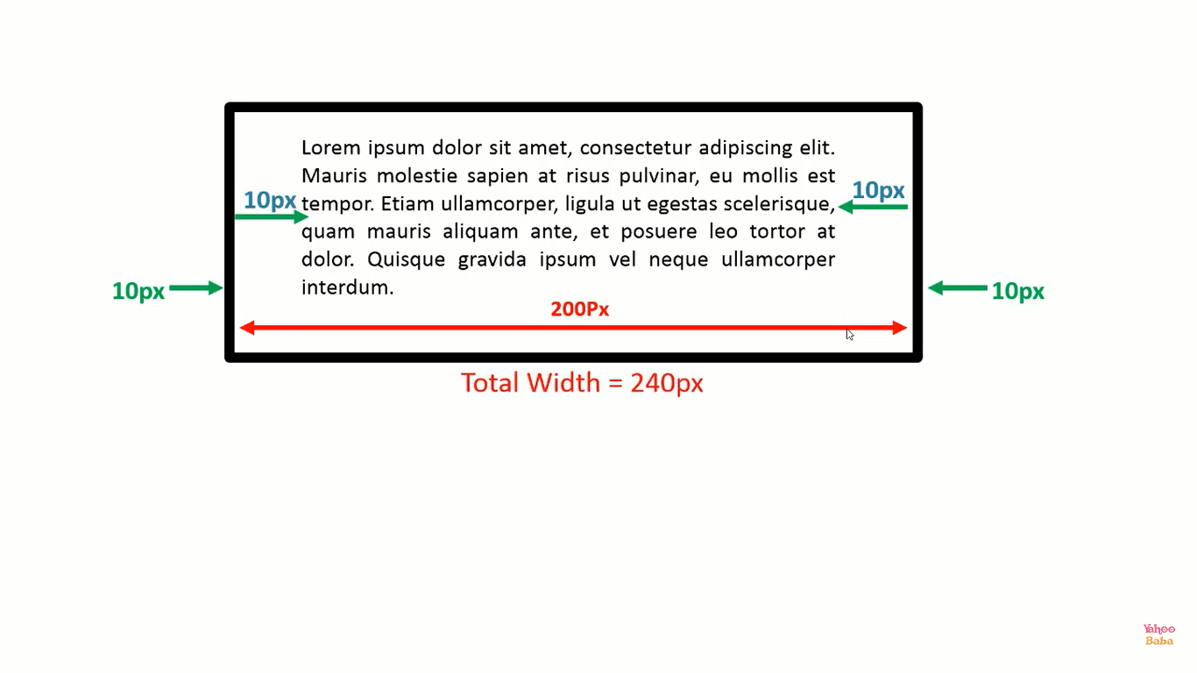
box-sizing
Total width = content width + padding + border width

Slide 32
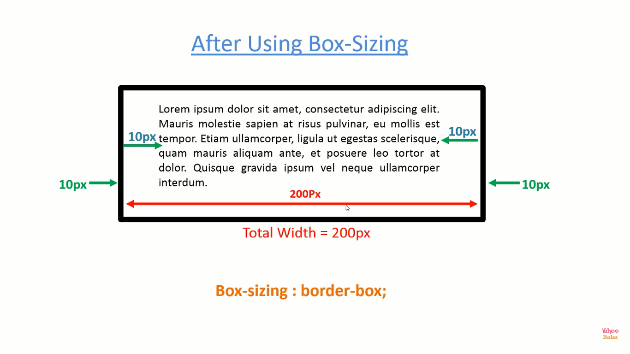

Slide 33
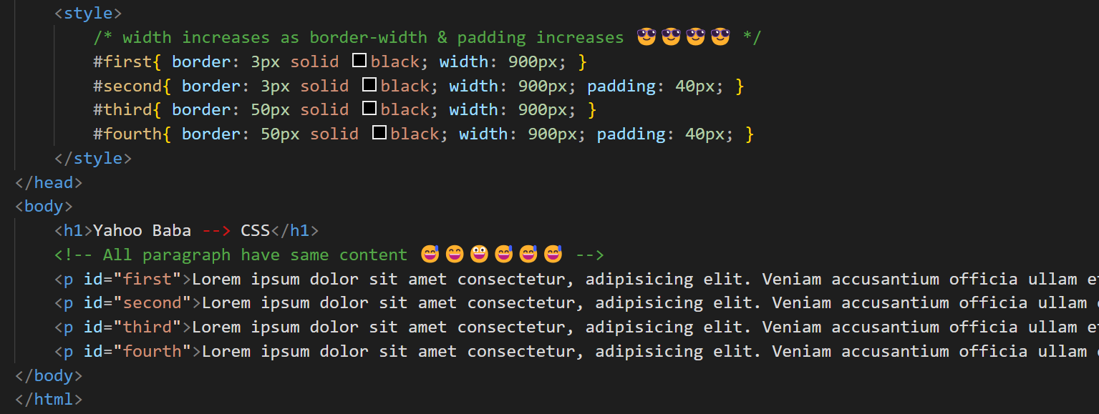

Slide 34
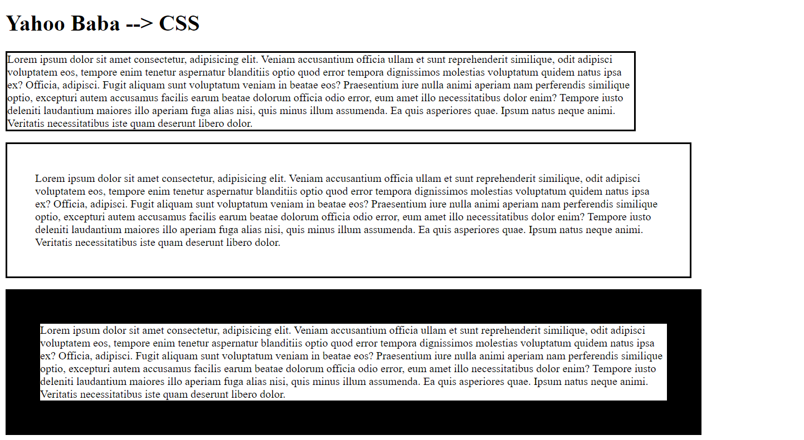
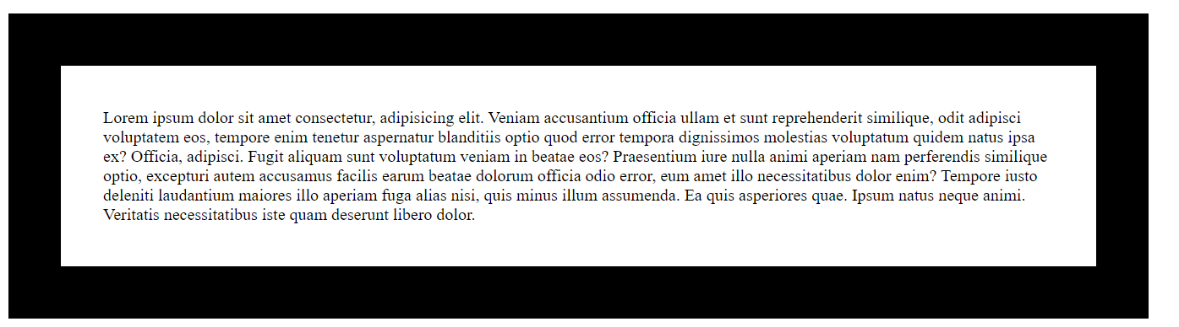

Slide 35
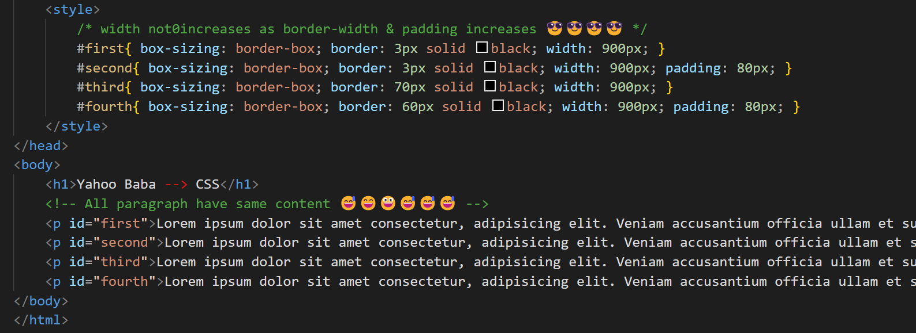

Slide 36



Slide 37


Slide 38


Slide 39



Applicable for both horizontal & vertical
Applicable for horizontal only
Applicable for vertical only
By Default

Slide 40


Slide 41


Slide 42


Slide 43


Slide 44


Slide 45



Slide 46

Outside the Box
Value of h-offset & v-offset can be in –ve also

Slide 47
Inside the Box
inset ;
Value of h-offset & v-offset can be in – also

Slide 48


Slide 49


Slide 50


Slide 51


Slide 52


Slide 53


Slide 54


Slide 55


Slide 56


Slide 57


Slide 58

Ranges from [ 100 – 900 ]
[100, 200, 300, …. , 900 ]

Slide 59




Slide 60


Slide 61


Slide 62


Slide 63


Slide 64


Slide 65




Text-align

Slide 66




Text-align-last

Slide 67



Text-transform

Slide 68


Text-indent

Slide 69


Word-spacing

Slide 70


Letter-spacing

Slide 71


Slide 72


Slide 73


Slide 74


Slide 75


Slide 76


Slide 77

By-default

Slide 78


Slide 79

Normal
Word-break : keep-all
Word-break : break-all

Slide 80


Slide 81


Slide 82


Slide 83


Slide 84




Slide 85


Slide 86


Slide 87



Slide 88


Slide 89



Slide 90


Slide 91


Slide 92


Slide 93


Slide 94



Slide 95


Slide 96


Slide 97


Slide 98

Not Too Much Important 😊😊😊

Slide 99


Slide 100

Not Too Much Important 😊😊😊

Slide 101

Not Too Much Important 😊😊😊

Slide 102


Slide 103


Slide 104


Slide 105


Slide 106

Short-hand

Slide 107


list-style-image

Slide 108


list-style-position

Slide 109


list-style-type

Slide 110


Slide 111


Slide 112


Slide 113


By-default
Stretch Image to some extent

Slide 114


Slide 115

Xpx Ypx

Slide 116


Slide 117

By-default

Slide 118



Background-attachment : scroll
After Scrolling picture moves upward

Slide 119

Background-attachment : fixed
Even After Scrolling picture stay of it’s position

Slide 120


Slide 121

By-default

Slide 122


Slide 123

By-default

Slide 124


Slide 125

By-default

Slide 126


Slide 127


Slide 128


Slide 129


Slide 130


Slide 131


Slide 132


Slide 133

Values lies between [0, 1]

Slide 134


Slide 135


Slide 136


Slide 137


Slide 138


Slide 139


Slide 140

1) display : none ⬅=== Remove Presence of elements and its area.
2) display : inline ⬅=== block elements acts like inline.
3) display : block ⬅=== inline elements acts like block.
4) display : inline-block ⬅=== block elements behave like inline but some
properties like width and Vertical-margin are not
working properly so using this those properties are work like
element is block element.
5) display : list-item ⬅===element behaves like list-item “<li>.

Slide 141


Slide 142


← By-default.
← Remove Presence of elements and but not its area.
Remove Presence of elements and but not its area.
←-- For <table> tag specially.
← Remove Presence of elements and but not its area.

Slide 143
HTML Practice

